Slide 1
Aggregate Functions in SQL

Slide 2
Functions
Count
Avg
Max
Min
Sum

Slide 3
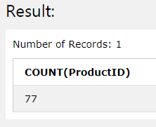
Count
SELECT COUNT(ProductID) FROM Products;
SELECT COUNT(*) FROM Products;

Slide 4
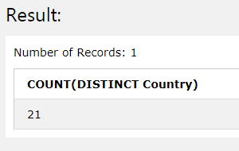
Count with Distinct
SELECT COUNT(DISTINCT Country) FROM Customers;

Slide 5
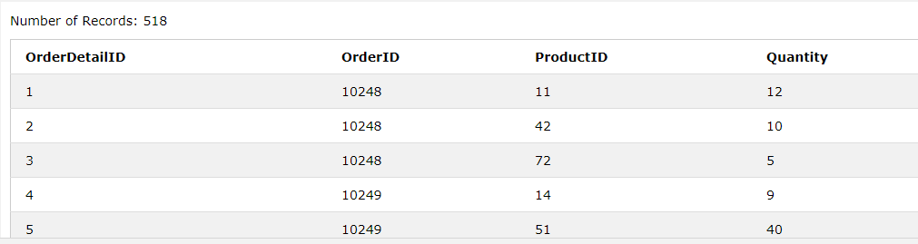
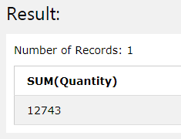
Sum
SELECT SUM(Quantity) FROM OrderDetails;

Slide 6
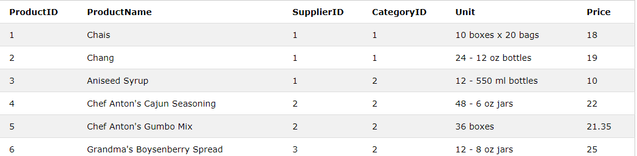
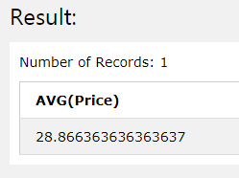
Avg
SELECT AVG(Price) FROM Products;

Slide 7
Min and Max
SELECT MIN(Price) AS SmallestPrice FROM Products;
SELECT MAX(Price) AS LargestPrice FROM Products;

Slide 8
The GROUP BY statement is often used with aggregate functions (COUNT, MAX, MIN, SUM, AVG) to group the result-set by one or more columns.

Slide 9
The following SQL statement lists the number of customers in each country:
SELECT COUNT(CustomerID), Country FROM Customers GROUP BY Country;

Slide 10
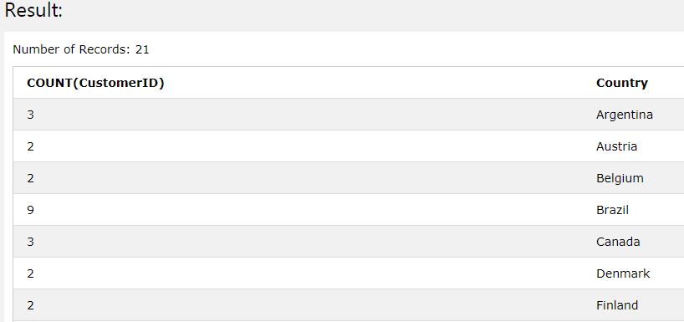

Slide 11
The following SQL statement lists the number of customers in each country, sorted high to low:
SELECT COUNT(CustomerID), Country FROM Customers GROUP BY Country ORDER BY COUNT(CustomerID) DESC;

Slide 12
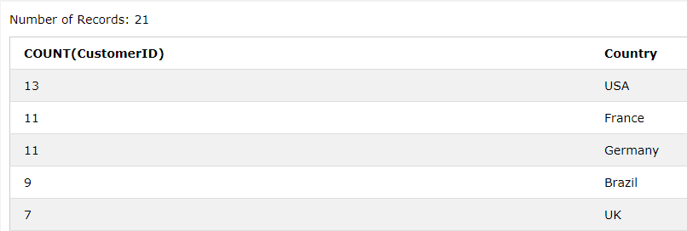

Slide 13
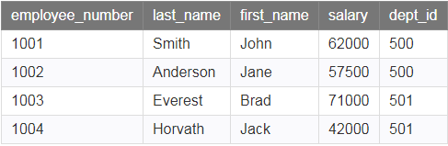
Example
Find out How much Salary each Department has to Pay to its Employees.

Slide 14
Find out Lowest Salary offered in Each Department.
Find out Highest Salary offered in Each Department.

Slide 15
SELECT dept_id, SUM(salary) AS total_salaries FROM employees GROUP BY dept_id;
SELECT dept_id, MIN(salary) AS lowest_salary FROM employees GROUP BY dept_id;
SELECT dept_id, MAX(salary) AS lowest_salary FROM employees GROUP BY dept_id;

Slide 16
Having Clause
The HAVING clause was added to SQL because the WHERE keyword could not be used with aggregate functions.

Slide 17
The following SQL statement lists the number of customers in each country. Only include countries with more than 5 customers:
SELECT COUNT(CustomerID), Country FROM Customers GROUP BY Country HAVING COUNT(CustomerID) > 5;

Slide 18
Query Examples
Select Department names where Minimum Salary is at least 20000.
Select names of the department where at least 5 female employees work.

Slide 19
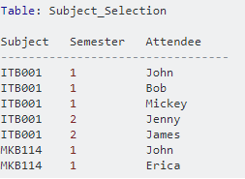

Group by on Multiple Columns
select Subject, Count(*) from Subject_Selection group by Subject

Slide 20

select Subject, Semester, Count(*) from Subject_Selection group by Subject, Semester

Slide 21
Subqueries
A subquery is a SQL query nested inside a larger query.
A subquery may occur in :-
A SELECT clause
A FROM clause
A WHERE clause
A subquery is usually added within the WHERE Clause of another SQL SELECT statement.

Slide 22
Use of Subqueries
Compare an expression to the result of the query.
Determine if an expression is included in the results of the query.
Check whether the query selects any rows.

Slide 23
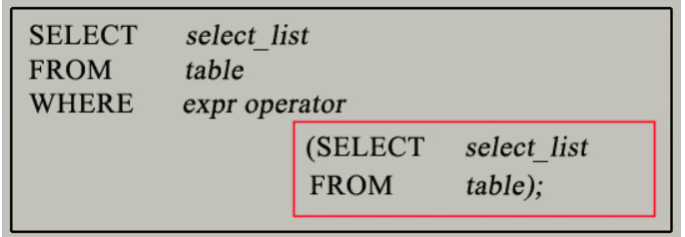
Syntax

Slide 24
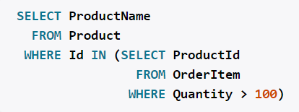
Example

Slide 25
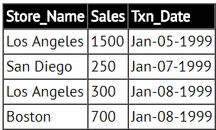
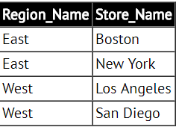
Example
Find the sales of all stores in the West region.

Slide 26
SELECT SUM (Sales) FROM Store_Information WHERE Store_Name IN (SELECT Store_Name FROM Geography WHERE Region_Name = 'West');

